Slide 1
Celtic History
Barbarism vs. Cultural Identity

Slide 2
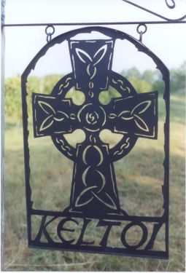
Celtic Origins
-Nomadic
-Not originally European
-Settled near the Danube & conquered neighbors
-Short Conquering period
-Only written history was by the Romans & Greeks
-Considered outsiders

Slide 3
The people… According to Rome.
-Independent tribes and family groups without formal identity
-Stubborn & refused to be conquered
-Each tribe was ruled by its own independent Chieftain
-Subgroups: Clans & Fines
-Considered barbaric & unrefined

Slide 4
The People… For Real.
-Highly developed society:
Royal Clans
Warrior Aristocracy
Freemen
-Highly advanced for the era:
-Produced chain mail for battle
-Grain reaping machine
-Soap
-Roads before the Romans
-Culturally simple
-Educated

Slide 5
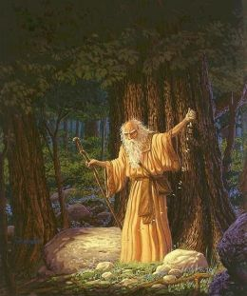
Smarts and Tarts
-Druids: Priests & Educators
-Devoted 20 years to education of specific trades
-Developed language early; only used for coinage and memorials
-Placed high value on memorization & recollection

Slide 6
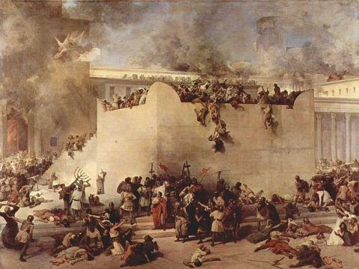
Oblivion.
-Conquered by Rome
-Given a racial identity by Romans
-Enjoyed brief respite when Rome fell
-Quickly reconquered by Germanic peoples

