Slide 1
Celtic Myths: The Otherworld
Deities & gods from the Celtic culture

Slide 2
The Sidhe, Annwyn, & Avalon
Fairyworld – IE, Heaven
Hidden from the world by magic
Time was stationary; forever young
Stationed by lakes, rivers, forests, islands, cottages, etc…
Known as a kind of paradox
Only touchable/manipulated in special circumstances

Slide 3
Gallic Deities:
Scattered Worshippers
Aericura – god of the underworld
Arduinna – goddess of hunting [Artemis & Diana]
Smetrios – god of war [Ares/Mars]
Cernunnos – god of nature [Hermes/Mercury]
Lugus – god of light [Apollo]
Brigindo – goddess of the arts, crafts, fertility, and sometimes war [Athena]
Note: Some of these are Gallic gods, and some are Roman-Gallic.

Slide 4
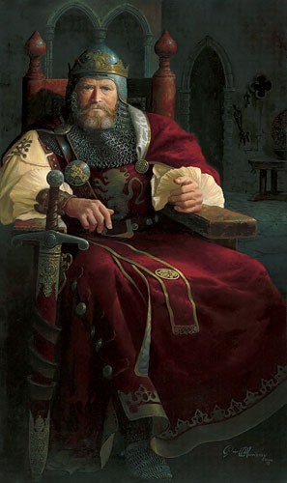
Human-Deity Relations
Like most religions, kings were married to both the deity and the land
Marriage to the goddess of fertility ensured agricultural success in the land
Earth was represented by female entities

Slide 5
Story Time!
Part I
A number of women/goddesses were called "The Sovereignty of the Land". The most famous was Morrigan; but others included the sisters Eriu, Banba, & Fodla. Eriu became the wife of two Irish kings, and the mother of another (super fertility play for Ireland, yeah?) Her sisters married the king brothers to one of her husbands (remember, we had lots of individual kingships). One day, the Milesians came to town and in the knowledge they'd win, all three sisters offered the conquerors something in exchange for naming the land after the goddesses. Eriu offered them instant victory over her people… and she won the bet. Everyone fell – and the Milesians named the island after her – also known as the "Erie Isle".

Slide 6
Story Time!
Part II
As for the goddess Morrigan, she (they?) had an interesting quality. Her two to three sisters Badb, Macha, & possibly Nemain were each considered to possibly be a trinity figure. The three sisters were combined and called 'Morrigu', and that each individual represented a different function/personality in the one entity. They were the three goddesses…or one goddess with three roles… of war. All, regardless of their stations, were married to high kings of Ireland.

Slide 7
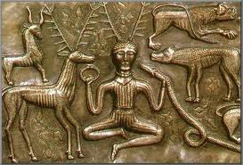
Bottom Line
The deities of Celtic lore are interchangeably like the religions around it.
Roman and Greek gods were essentially the same.
Christian similarities existed in the lore.
The gods are directly interconnected with humanity in physical relationship.
The relationship between the leaders and the gods affected the success of the land.

