Slide 1
Celtic Mythology
Warrior Society

Slide 2
Song to the Lady of the Fair Hair (Book of Heroes)
O Lady of the fair hair
Sing to me of the fair ancient land
Your divine voice
Whispers the poetry of magic
That flow through the wind,
Like sweet-tasting water of the Boyne.
"Girls forever young and beautiful,
Dancing around the broken Dun,
Where long forgotten heroes
Sang of victory
And drank ales
To old memories.
"Sing to me one last time,
Goddess of the fair hair,
Before my old ear fail me.
Let me see you dance,
Before your beauty fades away
From my failing sight."

Slide 3
Warrior Class
Celts divided their people by clans & social classes
Warrior class: Kings, chiefs, warriors & blacksmiths
Kingship/Chieftain position was earned
Sacerdotal class: Druids, bards, & ovates [priests & seers]
Working class: Freemen [Farmers, breeders, craftsmen, & servants]

Slide 4
Celtic Warriors
Original mohawks
A head taller than most Mediterranean foes
Gruesome reputation with other more "civilized" nations
Each area developed new skill: Spain – Swords; France – Armor & long swords; Britain – Chariots.
Manliness was the ultimate honor
Regarded as heroes among the people
Chopped off heads & mounted them to their belts & horses [Spiritual move]
Horned helmets, blue war dye, & pursuit of glory

Slide 5
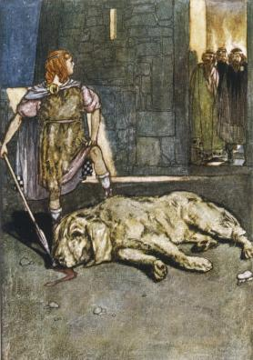
Hero: Chu Chulainn
Told in the Ulster Cycle
"Demi-god"
Gained name from killing Culann's fierce guard dog

Slide 6
The story of Chu Chulainn
The son of a god & the daughter of a king, Chu Chulainn leaves his homestead as a young boy to join the boy-troop at Emain Macha (after mom & dad hadn't let him before). Unknowing of the custom, he does not ask for protection from the troop. They take this as a challenge, and they both fight – little Chu Chu wins. Conchobar - the adult [and king/Grandpa] in the situation– breaks up the fight and clears up the misunderstanding… but as soon as he gets the boys' protection, Chu chases after them, demanding they put themselves under his protection.
Culann (the guard dog smithy guy) then invites Conchobar over for fun times. Conchobar sees his grandson kicking butt hurling in the field, and tells him to come with him. Setanta (his name before he's called Chu Chu) tells him he'll catch up with him when he's done with his game. Grandpa forgets… and when Setanta comes over, Culann turns his giant puppy loose on him. Setanta kills the dog in self-defense, and when the owner is sad that his dog dies, (rightfully so), Setanta offers to find a replacement, and until he does, he himself will guard Culann's house. So the Druid of the home named him Chu Chulainn, which means Culann's Hound.

Slide 7
The Cattle Raid of Cooley
http://www.timelessmyths.com/celtic/ulster.html#Cuchulainn

