Slide 1
Ms. Levine’s Two Cents:
Common Sense & Some Pointers on Proper Academia

Slide 2
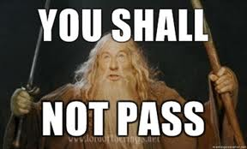
Take notes.
Or…

Slide 3
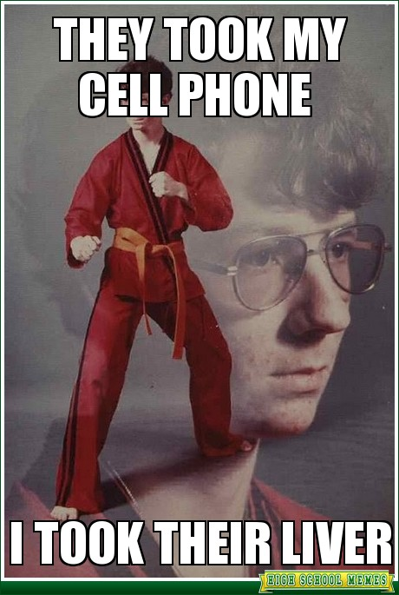
Cell phones. Um, no.
Fighting for your attention is not really my style. But I will defend my liver at all costs. Come at me, bro. (JK,
Please don’t come at me,
I don’t like pain.)

Slide 4
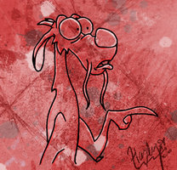
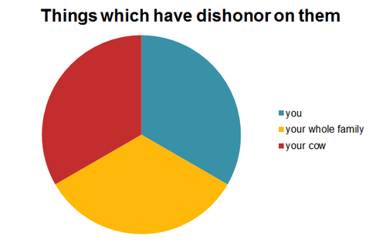
Reeeeeeeeeeeeeeeeeead.
If you don’t read…dishonor on you and your cow.

Slide 5
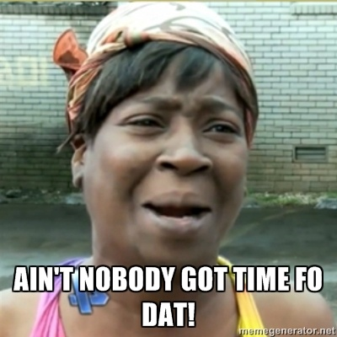
Side Conversation…chill.
I love rabbit trails just as much as the next rabbit. But…let’s stay on task.

Slide 6
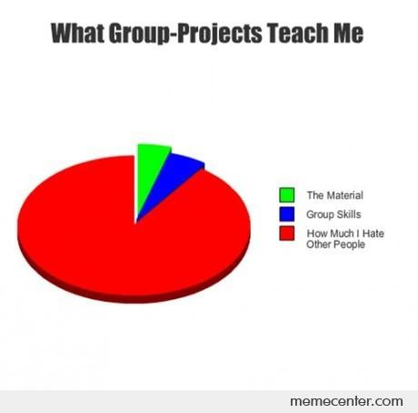
Walk it Out – group work
Yeah, it’s a pain. But in order for it to work the way the psychologically brilliant say it does… y’all gotta work equally and together.

Slide 7
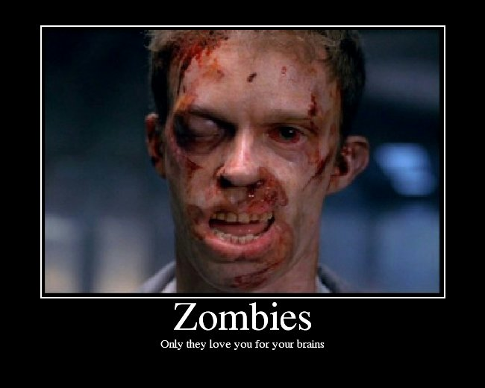
Write like you’re the last.
Imagine that Zombie Apocalypse has occurred, and whatever you have written will be the first thing normal civilization reads when the virus has subsided. Let’s
leave a good
reputation for our
generation.
Make it good.
Make it professional.
Make it matter.

