Slide 1
Lyrical
Poetry and Music

Slide 2
The World Is Too Much With Us
William Wordsworth (like Blake) was an artist, and along with people like John Constable, believed industrialization separated people from nature
Painting on 746 – How does Constable use color to show alienation from unity with nature?
Check out line 2. What’s that mean in the context of the poem?
Why is the phrase “Great God!” in line 9 ironic considering lines 10-14?
How is our connection to materialism nowadays similar to the struggle between industry and nature?
What kinds of things do you find valuable? Have you lost something you used to value in place of something else you presently value? In what modern cultures do you see a prevalence in materialism?
What allusions do you see in this poem?

Slide 3
Madonna: Material Girl
https://www.youtube.com/watch?v=0k3GTW3ecvo
Compare with The World is Too Much With Us, William Wordsworth
This was in the 80’s… have we changed since then? How?
Do you know who Madonna is imitating in this picture?

Slide 4
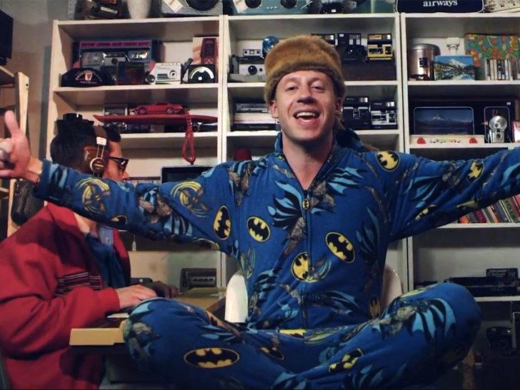
Macklemore: Thrift Shop
https://www.youtube.com/watch?v=hDZNP9pelRE
Contrast with The World is Too Much With Us, William Wordsworth & Madonna’s Material Girl
Is this a parody? Why?

Slide 5
She Walks in Beauty
George Gordon, aka Lord Byron
Simile: comparison between seemingly two unlike things
If you saw someone ‘pretty’ across the way… with what could you compare them so that you could emphasize their beauty/hotness?
What is the comparison through simile that Byron uses?
Justification for linking them?
What words connect her outer beauty to her inner beauty?
What is the main idea of this poem? Could it just be purely aesthetic?

Slide 6
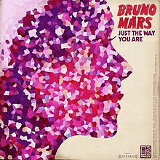
Bruno Mars: Just The Way You Are
https://www.youtube.com/watch?v=LjhCEhWiKXk
Compare & contrast with Byron’s She Walks in Beauty
Is this a commentary on outer beauty or inner beauty? Both?
What kind of girlfriend in the video would have made the song more poignant?

Slide 7
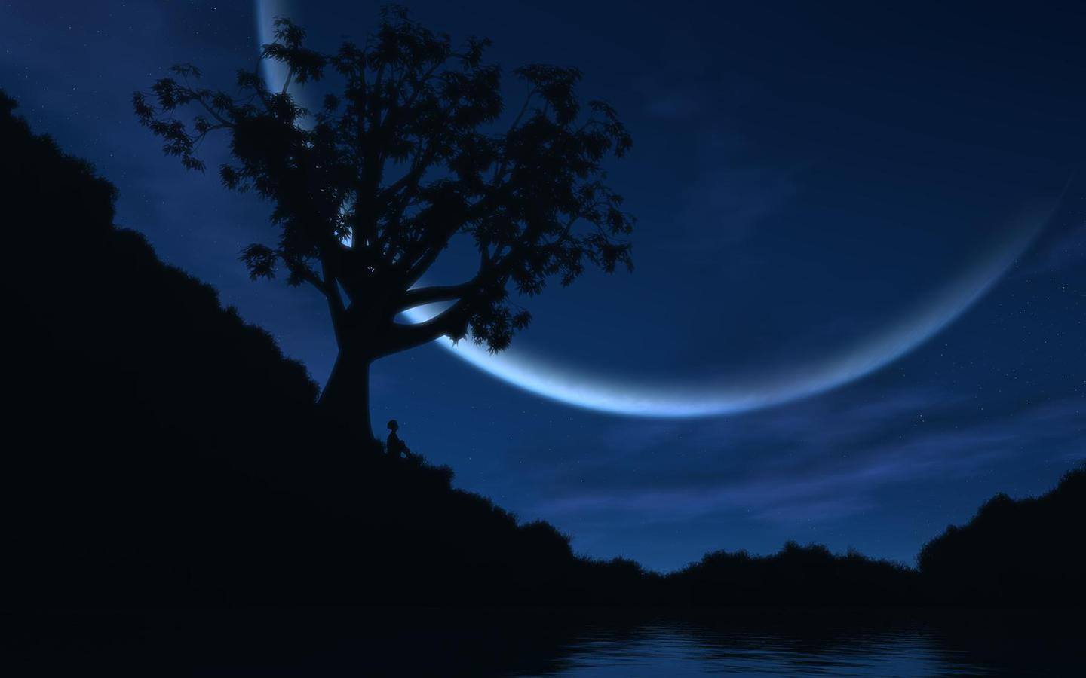
The Afters: Beautiful Love
https://www.youtube.com/watch?v=vX9h4PPx41I
Compare with Byron’s She Walks in Beauty.
This song talks about new/potential love. How does that relate to Byron’s poem?

Slide 8
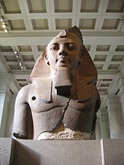
Ozymandias
Percy Bysshe Shelley
What is this a commentary on?
What kind of monument would a proud ruler erect for self-glory/honor?
Why do you think the first speaker never names the traveler?
What kind of person was Ozymandias?
How does the setting convey irony in the inscription?
Is legacy important? What kind of legacy do men usually seek?
What kind of legacy do you want to leave behind?

Slide 9
Iron Maiden: The Legacy
https://www.youtube.com/watch?v=ECbJdeh1VvA
Contrast/Compare with Shelley’s Ozymandias
Different kinds of legacies? How are the literary legacies and personal legacies different? Are they both important, or is one more imperative than the other?

Slide 10
Assignment!
Write in one page a life legacy for which you want others to remember you. Include the literary concepts of simile and allusion in your work. This legacy will be left for your children & your children’s children. Make it good. ;)

