Slide 1
Longfellow, Whittier, Lowell & Holmes
The New England School of Romanticism
11th Grade English Tri-Cities Christian School

Slide 2
American Romanticism - Refresher
1820 - 1965
Optimistic feelings of nationality -United State population rose [immigrants] -Frontier was expanding due to immigrants working the land -Technological advances brought about communication, agricultural, industrial & traveling expansions [Telegraph lines, vulcanizing rubber, guns, steel plow, railroads, Erie Canal … and oil.] Lots of money. Lots of buzz.
Sometimes, the good had to mix with the bad…Sectionalism
Cultural provincialism: “There must be more than this provincial life” -Hindrance #1: No international copyright. -Hindrance #2: Limited perspective and experience of American readers
Hawthorne, Melville, & Poe fought these provincial tendencies and made American literature more profoundly universal instead of confined and limited to a brand new American culture.

Slide 3
Romanticism in Literature - Emphases
As is the case with most new literature movements…Romanticism was viewed as a revolt from the previous period of literature. It is the second of four major American movements (St. John, 140).
In terms of literature, romantic does not mean roses and chocolate.
Individualism: An inherently American trait. Man is more distinguished in his individual state as opposed to being a part of the masses. Think about the frontier mentality. Moving out West to make a better life created the need for independence and the need to explore options outside of the crowded, overworked cities. There was freedom there. -Spiritual application: How is this dangerous to a Christian?
Imagination: Prior generation = Reason. Romantic generation = Imagination and deviation from the standard ways of thinking. “Reason was displaced by Emotion” (St. John, 141). -Spiritual application: Standards for Truth became internalized and subjective. These are the stepping stones to the present philosophies of Post Modernism.

Slide 4
Romanticism in Literature - Emphases
Nature: With man’s move toward independence, Nature became the focus for this philosophy in literature (and in learning). This is a major theme in most Romantic writing. Prior movements used nature as a device to reveal God. Romanticism regarded “Nature” as a god itself. -Spiritual application: Because man was becoming more reliant on the self, he then rejected the need for God, and replaced it with Nature. As a whole, Nature is the god of the flesh.
The distant: A lack of concrete, tangible setting and/or ideas. Indefinite concepts make up a lot of the Romantic work. No works that exist in the present. Mostly past or future. -Spiritual application: Living in places other than the present create problems for the Christian who either try to live in past mistakes, or try to ignore present problems by only focusing on the future. Remember, those who live in the past are doomed to repeat it.
Remember: Although these works are considered great and profound, the philosophies that accompanied their writers are a continued watering down of Absolute Truth, and must be scrutinized with great discernment by Christian readers.

Slide 5
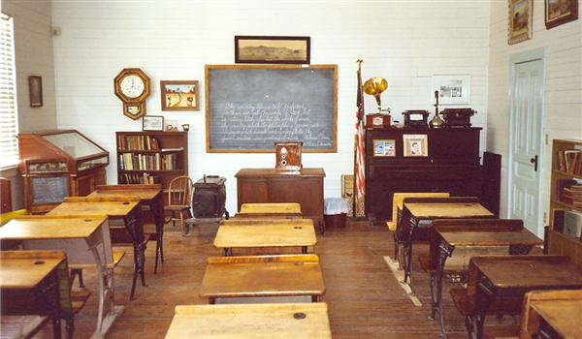
Romanticism: New England School
Writers were centered in Boston, MA
Not an actual school ;)
Included: Henry Wadsworth Longfellow Oliver Wendell Holmes John Greenleaf Whittier James Russell Lowell
“The Schoolroom Poets” -Simply because they were frequently taught in most schools up until the 20th century

Slide 6
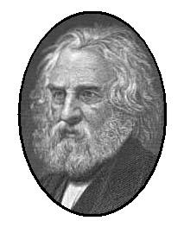
Romanticism: Longfellow
The Song of Hiawatha
B. 1807 – D. 1882
Things happening around his poem The Song of Hiawatha: -Gold Rush -Connection of New York and Chicago by railroad -Darwin’s Origin of Species
Works were universal – popularity expanded out to England as well as America.
Professor Longfellow (Well that’s fun.)
Most versatility in his work
Most of his work drew from the past
Took European themes and Americanized them
Some of his greatest work came after the death of his second wife (as a lot of good writing comes from dramatic personal experience).

Slide 7
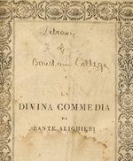
Romanticism: Longfellow
Divina Commedia Henry Longfellow
Oft have I seen at home cathedral door |*All religious references have to do with A laborer, pausing in the dust and heat, |church, and not a direct interaction with Lay down his burden, and with reverent feet |God. Enter, and cross himself, and on the floor |*Does this feel like a Commedia?
Kneel to repeat his paternoster o’er; |*What kind of tone does this poem Far off the noises of the world retreat; |express? The loud vociferations of the street |*Does the narrator get the respite he Become an undistinguishable roar. |looks for in the cathedral? Why or why
So, as I enter here from day to day, |not? And leave my burden at this minister gate, Kneeling in prayer, and not ashamed to pray,
The tumult of the time disconsolate To inarticulate murmurs dies away, While the eternal ages watch and wait.
*Paternoster: the Lord’s Prayer (Latin) *Minster: cathedral
*Disconsolate: inconsolable *Vociferations: shout
*Inarticulate: uttered without distinct sounds

Slide 8
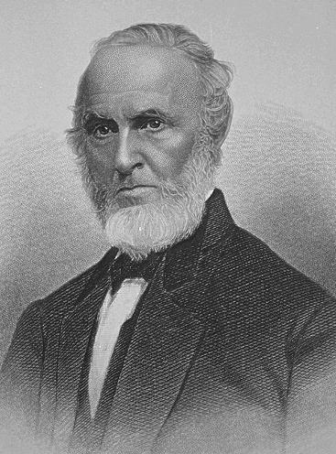
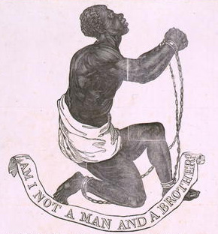
Romanticism: Whittier
B. 1807 – D. 1892
Lead voice in literature against the forces of slavery
Least typical of the Schoolroom Poets
Unlike Longfellow, he was not completely educated
Devout Quaker
Nearly killed twice by a mob due to outspoken abolitionist activity
Second in popularity behind Henry

Slide 9
Romanticism: Whittier
Ichabod John Whittier
So fallen! So lost! The light withdrawn But let its humbled sons, instead, Which once he wore! From sea to lake, The glory from his gray hairs gone a long lament, as for the dead, Forevermore! In sadness make. Revile him not, the Tempter hath Of all we loved and honored, naught A snare for all; Save power remains; And pitying tears, not scorn and wrath, A fallen angel’s pride of thought, Befit his fall! Still strong in chains. Oh, dumb be passion’s stormy rage, All else is gone; from those great eyes When he who might The soul has fled: Have lighted up and led his age, When faith is lost, when honor dies, Falls back in night. The man is dead! Scorn! Would the angels laugh, to mark Then pay the reverence of old days A bright soul driven. To his dead fame; Fiend-goaded, down the endless dark, Walk backwards, with averted gaze, From hope and heaven! And hide the shame! Let not the land once proud of him Insult him now Nor brand with deeper shame his dim, Dishonored brow.

Slide 10
Romanticism: Whittier
Where does the title Ichabod come from? [Top of 184]
What does this little boy have to do with slavery?
How does his name (its meaning) embody the tone and themes in this poem?
Which side of the Civil War (which was not too far off) do you think Whittier sided with?

Slide 11
Question 2 on 184
2) Find as many Biblical allusions as possible in “Ichabod”. Discuss the appropriateness of each in terms of Whittier’s theme.
(Remember what an allusion is?)
I’ll give you the scripture, and you give me the line/idea it matches.
Isaiah 14:12; I Timothy 2:7 & II Timothy 2:26; Psalm 71:18; Genesis 9:20-23.

Slide 12
Allusions!
Lines 1 & 27: “fallen angel”. Webster is compared to a fallen angel (a Biblical reference to Isaiah 14:12 – “How are thou fallen from heaven, O Lucifer.”) ← This is Whittier’s way of saying Webster has fallen from greatness by supporting the evil of slavery.
Tempter’s snare & the fiends goading – I Timothy 3:7, and II Timothy 2:26 are a couple.
Webster’s gray hairs & glory that would have been his had he kept to his convictions – Psalm 71:18
Shame that Webster has brought on himself compares to the shame in the garden.

Slide 13
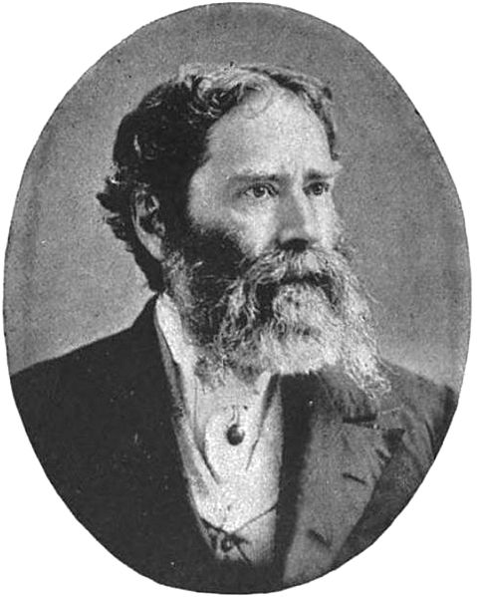
Romanticism: Lowell
B. 1819 – D. 1891
Author of poetry, as well as prose (the latter unlike the rest of the Schoolroom Poets)
Wrote an essay on Henry Thoreau that was highly detrimental to his reputation.
Good at critiquing other authors and poets – respected for his critiques
Professor Lowell (Harvard) as well as an international minister to Spain & England

Slide 14
A Fable for Critics Breakdown
He critiques Emerson, Bryant, Poe, and…himself.
This critique is what he is known for. And he’s pretty dead on with it.
Satire: Used to make a point about something in an entertaining, fairly humorous manner. -When critiquing people, satire may help soften the blow of the criticism. Otherwise, it’ll only make it worse. -Satire is in good fun.
He was respected by those he critiqued (Emerson)
Emerson Verse: His work shows lack of pleasing unity.
Bryant’s Verse: Good stuff, but not much warmth to it. (Find the part in his verse where Lowell uses a pun to get this point across. *Hint* The line is in the mid-20’s)
Poe’s Verse: Best poetry ever – little heart involved, and tons of brains.
Lowell’s Verse: At a disadvantage from all the preaching he does.
The tree metaphor (nature) is a criticism of Emerson’s lack of unity in this way: Emerson loved using nature (Romanticism!) in his poetry & often pushed this in others’ work. By using the natural “tree” to criticize Emerson’s work, Lowell is being ironic in this way.

Slide 15
Homework!
Read pages 184 – 193 in your textbook (Starting with Lowell)
Answer Q. 2 on page 188
Don’t forget to look up scripture references when noted in the margins.
If you ever forget your homework or need notes and/or this PowerPoint from class, you can always find them on my website: www.crayolakristy.weebly.com

