Slide 1
Pilgrim’s Progress: Chapters 12-20
Almost there, guys…

Slide 2
Chapter 12: The Pilgrim’s Suffer at the Vanity Fair
This place is crawling with crazies.
Imagine a fair. This is generally a nice scene. Great food. Kids running everywhere. Fun rides. Buying fun stuff.
Reality: Greasy food makes you sick. Kids all over can be distracting and dangerous. The rides are actually kind of lame at a lot of fairs I’ve been to. And the crème de la crème: the little stuffed bear your ‘guy’ won for you (or you won for your ‘gal’) at the booth where they often rip you off…doesn’t go two weeks without tearing.

Slide 3
Vanity Fair: Characters
Ring Leaders: Vanity, Beelzebub, Apollyon, and Legion. They own the town, and decided long ago that they’d start selling “meaningless” stuff at the fair that conveniently stood between a Pilgrim & his progress toward the Celestial City.
The Prince: Jesus (an important parallel for the things that happen to Faithful)
Judge Hate Good: Pretty self explanatory…just seeing his name tells you that the trial won’t go well.
The Witnesses: Envy, Superstition, & Gainglory.
The Jury: Mr. Blindman, Mr. Nogood Mr. Malice, Mr. Lovelust, Mr. Liveloose, Mr. Heady, Mr. Highminded, Mr. Enmity Mr. Liar, Mr. Cruelty, Mr. Hatelight, and Mr. Nosatisfying. ← Each of these names
The Other Guys: There are beau coup others that are considered ‘honorable’ – take into account the word ‘Mr.’ as its original word was ‘lord’, a title. These men were considered revered to their townspeople.

Slide 4
Vanity Fair: Conflict
This is some serious conflict up in here. Faithful & Christian run into some adversarial characters who are jeering at them and condemning them in their streets for not conforming to their “fair ways”.
As if the crowd hatred and profanity isn’t enough, their ‘sore thumbs’ get thrown in jail and Faithful’s vocal objections to the fair put him on trial before Judge Hate Good, and a jury of the peers of the fair – not of Faithful.
Although all this conflict is going on and pressing against the Pilgrims, it is important to note that they would have nothing to do with the same hatred and filth spewing that the townspeople displayed. They exuded Christ the entire time, even through Faithful’s trial. And because of that, even some in the town turned their hearts away from hating them and appreciated who they were in Christ. Perfect example of finding identity in Christ.

Slide 5
Vanity Fair: Ms. Levine’s Two Cents
What set them apart from the people of Vanity Fair? Three things.
Do you think it was on purpose that the four “Ring Leaders” set that fair up in the path to the Celestial City?
What kind of things are being sold at the tables? We have some of these things in our lives, don’t we? Land, business, titles, promotions, children, husbands, wives, silver, desires…etc… Why are they so unimportant? Look what these things that we have are mixed with though: brothels, blood, lives, servants, precious stones, souls, etc…
Connect The Prince’s experience with what happens to Faithful. Wasn’t it just so senseless? They put him on trial for being different from them – this is how offensive the Gospel is, folks. It makes evil loathe any who take up with the Cross. The aspects of Truth, kindness, meekness, and humility are completely gross, repulsive even, to those who live in the flesh. The hold of the flesh is far stronger than we give it credit for – this idea supports the fact that Christ is stronger than any other force in Creation.
The “Mr.” Collection. Bunyan originally called them ‘lords’. This is a significant difference for our understanding. These men were lords of the flesh. So if you look at it from an worldly perspective…it makes sense that they put Christian on trial for trampling over their rule with their humility and barbaric tactics. To us, however, we see this as senseless, and we see the pride and lust for power that the flesh seeks. This is the human condition, folks. This is mankind’s problem.

Slide 6
Chapter 13: Moneylover
“Becoming religious is a virtue, regardless of the means he employs to be so.” (pg 138). The answer to this question is on pg 139. ☺
This indicates that there is more than one way to be a Christian (John 14:6 disputes that)
Moneylover & the gang: from the city of Fairspeech
They use human reason & logic to justify their actions (the flesh)
These men are pompous
They are living on “milk” versus “meat”
Only want God for His blessings and not for His relationship
Blaring lack of submission; came to God on their terms and not his
Do not seek blessing
Humanism – it’s all about me
Pharisees → same religion (sought money & sought power)
Fear of God – these people have none

Slide 7
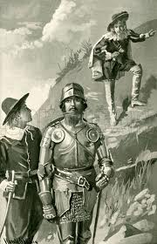
Chapter 13: Demas
The luxurious plain = Ease
Demas meets them at the entrance to the silver mine
Silver mine is the dangerous place
Demas is like a persistent sin
Our shame can always turn us to appreciate God’s grace (when Hopeful is shamed about wanting to go to the silver mine)
We always get rewarded in the end, but we do not seek the reward instead of the relationship. We are only benefited by it in light of the relationship.

Slide 8
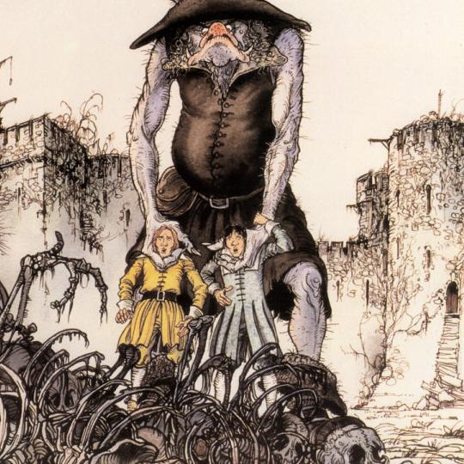
Chapter 14: The Pilgrims Deal with Giant Despair

Slide 9
Chapter 14 Thoughts…
Jesus said, “It were better for him that a millstone were hanged about his neck, and he cast into the sea, than that he should offend one of these little ones.” [Luke 17:2] -This verse was when Jesus had the little children come to him, and he used them as an example for new Christians being led astray. Christian’s sins are always forgiven, and they will move on, but this is one of the gravest sins.
Against better instincts, Hopeful still followed Christian down that path out of respect for his spiritual and possibly physical elder.
Bunyan’s dreaming narrator points out that it is easier to stray out of the Way when you’re in the way than to stray from it when you’re out of it.
Doubting Castle – owned by Giant Despair (The things that happen when we are “not ourselves” in the Way, like Christian)
They’re trapped for days without food, with serious injury and fear of death by crushing.
Despair can definitely being from our own doing, and it often leads to self-pity
Suicide kills the body AND the soul
Christian’s in a bad place at this point
Hopeful encourages him when all seems lost – this is our job as Christians
Key near his heart called Promise opens any gate in Doubting Castle.

Slide 10
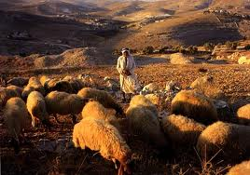
Chapter 15: The Shepherds
Shepherds meet them around the Delectable mountains
They’re kind to them; invite them to sleep for the night
They warn them of the Hills called Error & Caution Error: Bones of Pilgrims who make false assumptions about the nature of resurrection (like Ignorance has issue with) Caution: Blind travelers wander around tombs beneath that hill. Pilgrim’s get stuck
Pilgrims get a glimpse of the Celestial City & are super stoked
Warned again: Don’t sleep on the Enchanted Ground & don’t go near Flatterer.

Slide 11
Chapter 16: Ignorance
Ignorance accompanies them for a while
He hopes for the best & thinks a good life gets you to Heaven (His travel is only in body & not in mind or soul.
The pilgrims realize the folly in his beliefs, and they ditch him as not to be slowed down by him
The bound man = Little-Faith -Traveled with his birthright (Cf. Esau) & some $$ -$ Stolen by thieves -Has his jewel but doesn’t think of it -Hopeful gets an idea: Sell it for travel money -Christian tells him he’s a fool, and that you can’t sell faith for material comfort

Slide 12
Chapter 17:

Slide 13
Chapter 18
Christian is taking the role of the Family in chapter eight
Bunyan is starting to wrap up – wants to make sure readers can apply into this far to the message of the gospel
Faithful gave Hopeful an “example” prayer
Similarities between Christian’s Conversation & Hopeful’s: -Recognized their sin -Coming to Christ was not an immediate endeavor
Differences between Christian & Hopeful’s conversion: -Hopeful: Divine intervention -Christian: Came to the Cross at the hill

Slide 14
Chapter 19: Ignorance, Pt. II
Ignorance is not a bad guy -Misguided -Does not believe in the revelation from God → Not necessarily unsaved in terms of people we know today, but this man in particular ends up in the fire pit (Thank you, Cody.) -He’s not making progress (And that’s the point, right? To make progress) -Put off by the Pilgrims & doesn’t take interest in talking to them because he knows that they would encourage him to give more of him than he’s willing to put effort into
“I enjoy walking alone” – Enjoys lack of accountability → Easier. But really, it makes his progress harder
“I’ll never believe my heart is bad like that” – only submitted to the Law & not Christ
Believes he’s justified through his own righteousness & obedience to the Law & not in obedience to Christ and recognition of HIS righteousness & Grace → Ignorance’s big misconception about God -He’s applied Christ’s justification to his actions and not his person.
“Before I knew myself” – Young, ill-guided Christians; don’t apply Biblical awareness and wisdom of the Spirit.
To his credit: Ignorance recognizes cheap race & believes works are the solutions.
To his discredit: He doesn’t understand Paul’s ideas about “shall we go on sinning?”

