Slide 1
The Romantics
It’s not all chocolates and flowers

Slide 2
REALLY Basic Historical Background
Started with the French Revolution (1789)
England was changing from agriculture to industry
The ‘masses’ were tired, hungry, and overworked
“It was the best of times…”
Napoleon Bonaparte became the new dictator (crazy short guy, really quite vicious & brilliant)
England’s reaction to ‘revolution’ (America, France): Fail sauce. Went after Napoleon, too.
After success in the war with Napoleon, England was able to settle into the Industrial Revolution…where they gained a whole new mess of social problems. -Children workers -Many men losing land to “corporate” change -Migration to city caused overcrowding & awful living conditions
Laissez faire (les’ a fer) – rich got richer, poor got poorer

Slide 3
Revolution in Writing
Romantic period: sparked by history & by the prior writing/philosophical period (Skepticism of the Augustans)
Three meanings: 1) Child-like Wonder 2) Social Idealism 3) Adaptation to Change
Embraced nature, the imagination, the individual, and distant writings (the past, dreams, the future).
Strayed from reason & logic to evoke emotion & imagination (qualities of the Medieval period before the revolutions)
Lyrical Ballads
Poets of this time: -William Blake -William Wordsworth -Samuel Taylor Coleridge -Percy Bysshe Shelley -John Keats -George Gordon, Lord Byron

Slide 4
William Blake
Wrote Songs of Innocence and Songs of Experience.
Religious in tone; more importantly, expressed the state of mind in a distorted, limited fashion. -Innocence: ignorance (limiting) -Experience: abandoned ignorance (limiting)
Fascinated with the Bible – wanted answers to profound questions about good & evil
Concluded that progress comes from contradiction & duality
Humans embody contrary states of good & evil
Symbolism: literal & figurative

Slide 5
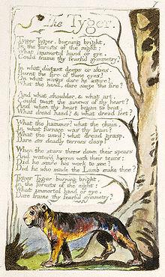
The Tyger
As we read, think about this as a poem of ‘experience’.
Tiger as a symbol for revolution (Positive but volatile)
Parallelism: rhythm & repetition
Once you revolt, there is no turning back
“Fearful symmetry” – duality
Could find a tinge of regret with the acknowledgement of sin entering earth/man (line 17)
Lines 1-2: what visual image is created?
What effect do we get from the parallel structures in stanza 4?
What does Blake imply with his line 20 question?

Slide 6
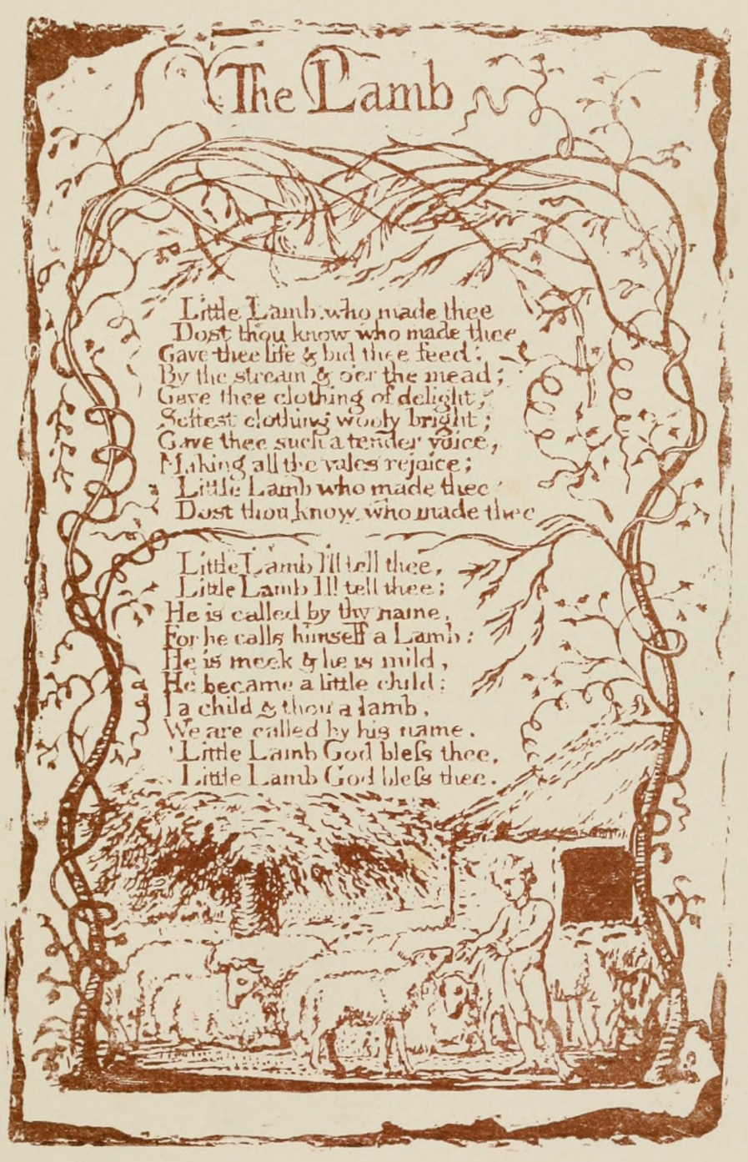
The Lamb
As we read, think about this as a poem of innocence
Contrast to The Tyger; already see the ‘good’?
Lamb as a symbol for Christ
A viewpoint of innocence
Emotions from the description of the lamb?
Words where you felt these emotions?
How do we know who ‘He’ is?
Where is the explicit Christian symbolism?
What is the difference in pace between The Lamb and The Tyger?

Slide 7
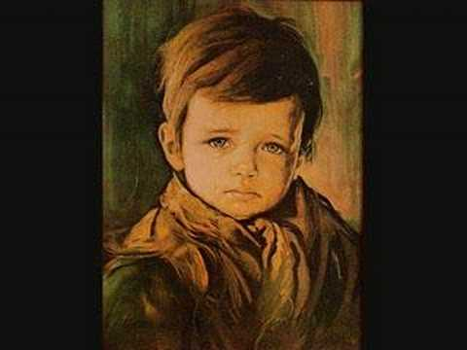
The Chimney Sweeper: Innocence
From Songs of Innocence and Songs of Experience
Poor children were used to clean the chimneys -Dangerous & children were ill-treated
Parallelism – examples in the text?
Purpose of the parallelism? (Remember who the speaker is?)
The speaker is optimistically trying cheer up a hopeless situation
What could “coffins of black” be a symbol for other than death?
Why does the speaker’s simplistic faith make us cringe when we get to the last line?

Slide 8
Chimney Sweeper: Experience
Realism vs. hope
Innocence: he still thought it would be okay.
Experience: he gave up, but held the façade
Black and white: connection to innocence & experience?
What constructions in the poem are parallel?
What does the parallelism accomplish?
Who is blamed for the child’s misery?
Compare the Chimney Sweeper poems to the Songs of Innocence and Experience. How are they similar? How are they different?

Slide 9
An English chimney
This is what
very young children had to climb down and clean.

Slide 10
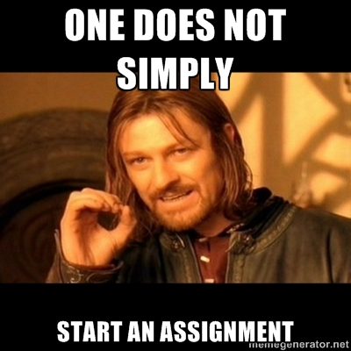
Assignment!
What are some events in your life that are innocent or experienced?
Take the handout and in the remainder of class, write your own poems of experience & innocence. If you do not finish in class, finish it for homework, and bring it back. We’ll share them in class tomorrow. ☺

