Slide 1
Transcendentalism: Optimists
11th Grade: First and Seventh Period

Slide 2
Transcendentalism: Introduction
Influential cluster of ideas affecting the Romantic period.
Ralph W. Emerson, Henry D. Thoreau, and Walt Whitman = supportive optimists
Edgar A. Poe, Nathaniel Hawthorne, & Herman Melville = critical pessimists
Origin - Immanuel Kant: “Knowledge not known through the five senses” (pg. 196)
Many thought it was a religion
“Fundamentally anti-Christian” (pg. 196)
Turned to Nature as their god: Over-Soul
This starts the idea that there is one god of the universe, but that each religion comes to that god through their own methods and ways.
Pantheism = worship of the universe as a god.
From this, the individual became the focus as opposed to society as a whole. (Egotism)
Emerson was the chief Transcendentalist writer
Remember when we discussed truth become internalized and subjective? These came from the works of Transcendentalism, and led to many dangerous present day beliefs and philosophies.

Slide 3
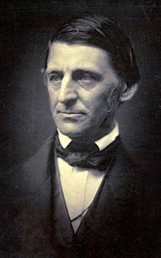
Ralph Waldo Emerson
His essay Nature is the ‘bible’ of the Transcendentalist movement
Harvard graduate
Pastored Boston’s Second Church
Resigned because of doctrinal differences (related to giving out the Lord’s Supper)
Well-traveled
His concepts often live through his “disciples”: Thoreau & Whitman.
Possibly the most influential writer of all time.
Analyzing his work gives us a look into a style of writing and ideas that is inherently American.

Slide 4
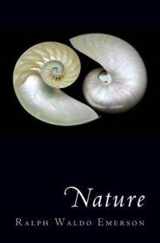
Emerson: Nature
We learn from doing. This is the start of the essay’s train of thought.
The climax of the essay (the height of the story) appropriately is the vision of everything gradually heading toward excellence & “precision”.
Blatant contradiction between how Emerson sees the future & how the Bible sees it (Ref. Romans 1)
This is why Optimists are called what they are – everything is being directed up.
The writer is considered a “visionary” or a modern day prophet who guides his readers.
Consider the lack of concrete, definitive structure in even this essay. Does this match with some of Lowell’s criticisms?
Do you notice anything similar to previous authors?

Slide 5
Assignment!
At your desk, turn to page 207. Find question #2. Answer every question in that paragraph, and write the answers down on a piece of paper with your name on it. When you are done, take time to look up the scripture at the end of the paragraph, and once you have discerned the correct biblical mindset, write a letter to Emerson defending the Truth. Your letter must be one page in length, and must have supporting scripture to remind him of his beginnings in the Word. You are, of course, not limited to the scripture listed in your textbook. Extra points for using other verses for support. ☺

Slide 6
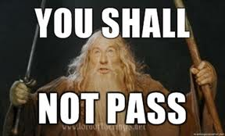
Homework!
Read Civil Disobedience (Pg. 210 – 213)
…Unless you take notes in class. Just sayin’. SLANT.

Slide 7
Henry David Thoreau
1817-1862
Harvard College grad
Lived with the Emerson family – “sponged” off of a secluded piece of property Emerson bought to be able to concentrate on his work better.
Non-conformist (Ref. Emerson quote from Self-Reliance) -Did not get married -Did not pay poll taxes often -Did not buy property -Did not work at a normal job
All a result of civil disobedience through passivity and refusal to join the masses (Individualism)
Naturalist writer
Idea from which Civil Disobedience sprung: conscience is above the law; and if the law does not agree with the conscience, that citizen has the right to break the law to protect his conscience.
In the end of things: Thoreau “begins & ends with the self, denies the fact of man’s corrupt nature, believes in salvation through self-achievement, and worships God only in nature” (pg. 209).

Slide 8
Thoreau – Civil Disobedience
Question 1 on page 221:
“Listed below are several points paraphrased from the excerpt of “Civil Disobedience.” Choose one of these points and defend or refute in an 8 sentence paragraph the idea embodied therein: a. Our country should have no standing army. b. The citizen should not delegate the task of lawmaking to elected legislators. c. With regard to justice of existing laws, the majority should not rule. d. The law makes well-intentioned men the agents of injustice. e. It is better to break the law than to petition the governor or legislature. f. All change is for the better.

Slide 9
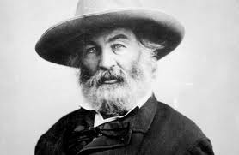
Walt Whitman
The final word in Emerson’s ellipses. Think of Emerson as a trailing thought, and Whitman as the completion to his thought.
Not a professor! Well, he was a teacher at one point…along with various other odd jobs.
Male nurse for wounded soldiers during the Civil War
Last of the Optimists
In regards to his work, he believes in TOTAL poetic freedom -Free verse -Content
Warning: Whitman usually has fairly open poems on sexuality and other scandalous topics. We, of course, will not discuss those. But they are a result of his thoughts on free writing and very broad, open style.
**Thoreau put Emerson’s ideas into practical use; Whitman developed Emerson’s ideas to their logical end.

Slide 10
Whitman: Song of Myself
It’s a little too long to put on a slide…so let me sum it up for you.
It celebrates the individual’s value
His intentions in the poem are free of restraint (Connect this to his free verse style)
Emerson: the self is solely depicted in the mind. Whitman: the self’s divinity is in not only the mind/spirit, but also in the physical body. I believe in the flesh and the appetites, Seeing, hearing, feeling, are miracles, and each part and tag of me is a miracle. Divine am I inside and out, and I make holy whatever I touch or am touch’d from, The scent of these arm-pits aroma finer than prayer, This head more than churches, bibles, and all the creeds.
Subject matter: “Nature”
Lack of limitation : “Without check”
Poetic mode: “With original energy”

Slide 11
Grass.
A major component of the poem because it reveals the six major motifs in the verse:
1) Optimism (16)
2) Benevolent creation (17-19)
3) Innocence (20)
4) Quality (21-24)
5) Death (25-37)
6) Immortality (38-45)
Universality to the poem – in the end, it no longer becomes just about Walt, it is supposed to become something we all relate to.

Slide 12
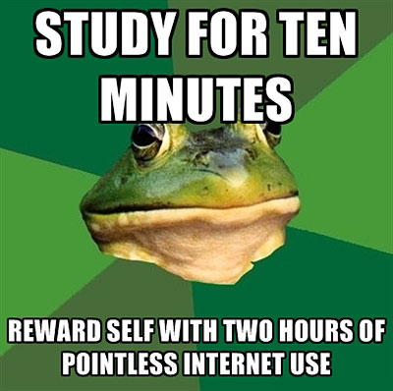
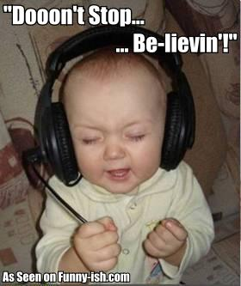
Homework!
1) Complete the free verse “Song Search” handout.
2) Study for tomorrow’s quiz.

Slide 13
Study Guide!
Elements of Transcendentalism : -Oversoul: The thing/spirit each person has that connects them to God (the idea that all religion connects us to ‘God’) -Nature -Individualism (Self-Praise)
Where Thoreau lived
Similarities between Thoreau & Emerson (Hint: Their work)
Label the idea of worshipping the universe as a god (PPT)
When did Truth first become internalized & subjective?
Is Transcendentalism a religion?
Define Egotism
Which piece is the Transcendentalist bible? (Emerson wrote it)
Emerson’s pastoral days
Positive aspects of Emerson’s work (essay question)
Thoreau’s idea of salvation
Connect free verse poetry to Whitman & Thoreau’s philosophies
The thing all three Optimist writers have in common? (Self-glory)
Four things Thoreau didn’t do like everyone else (PPT)
www.crayolakristy.weebly.com

